Slide 1
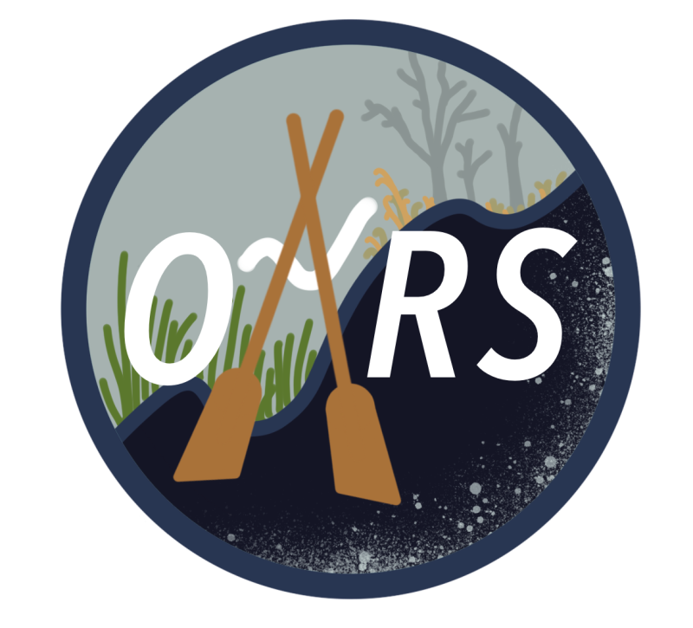





OARS Mid-Atlantic Tool Overview
Updated July 15, 2026

Slide 2
What is the OARS Mid-Atlantic Tool?
A guide to financing and implementing resilience practices on private land in the Mid-Atlantic impacted by saltwater intrusion.
User: Landowner or service provider
Content: Ingredients spreadsheet (e.g., programs, practices)
Format: Web tool (e.g., Petfinder)

Slide 3
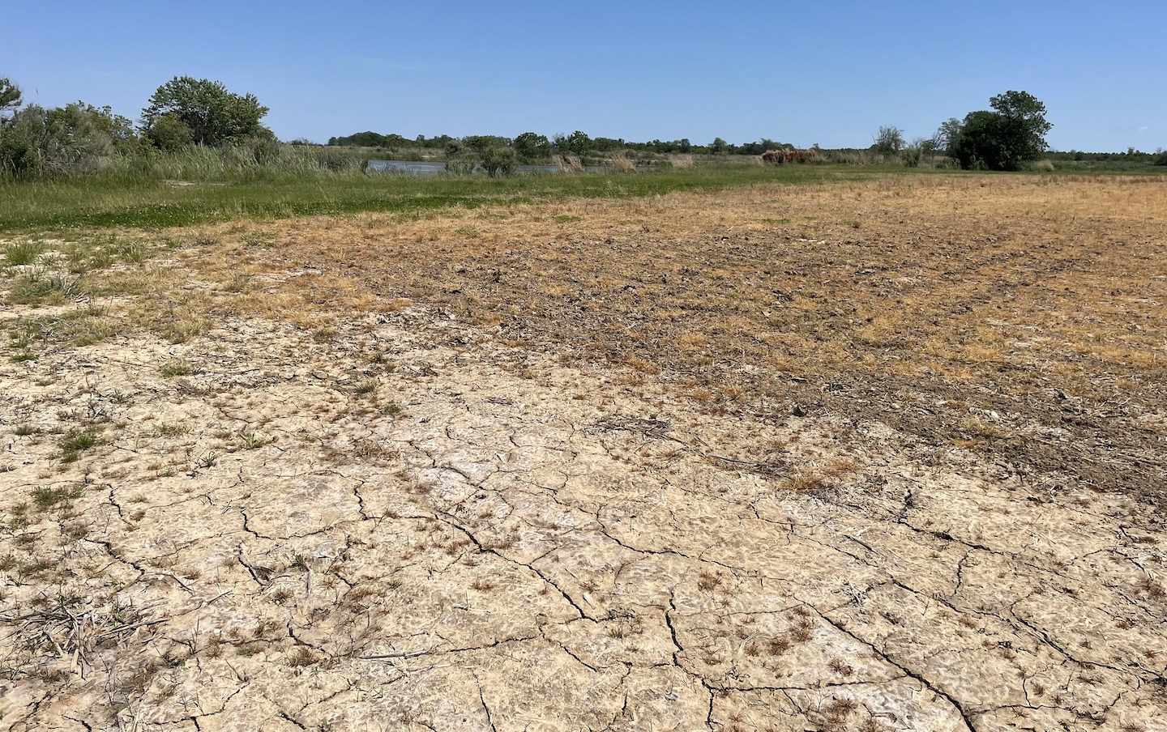
Step 1: Determine stage of SWI
Using visual indicators!

Slide 4


The OARS Scorecard
A tool to determine the stage of saltwater intrusion on a farm or forest.
User: Landowner or service provider
Content: Questions and scoring determine by RISING core team
Format: Web tool and PDF
No Impact
Marsh
No Impact
Marsh

Slide 5
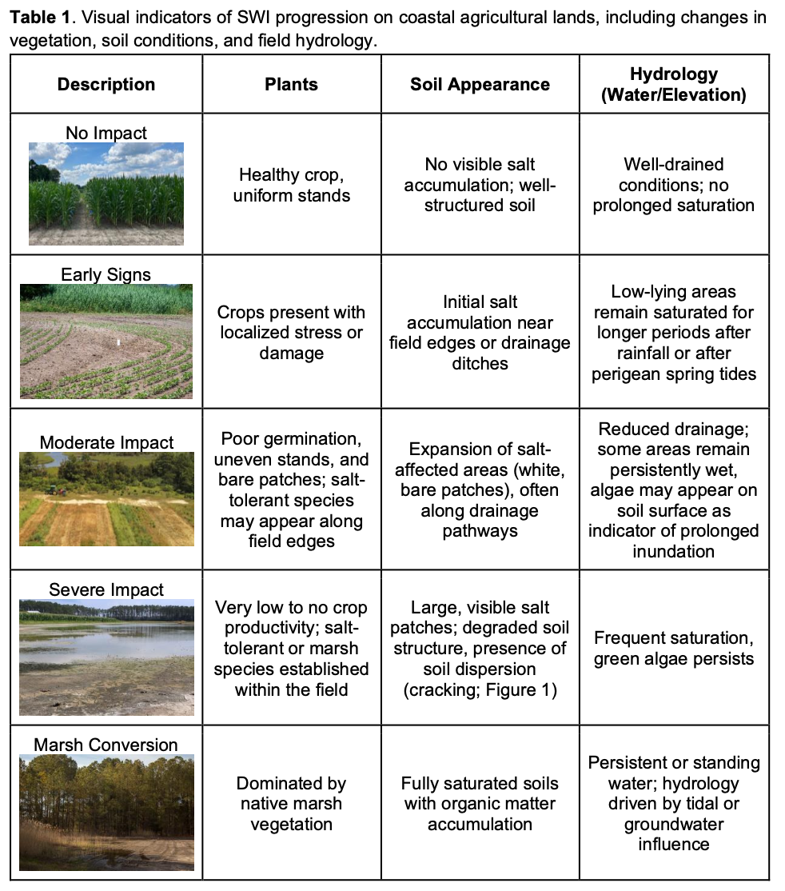
Visual indicators on farms
Schulenberg et al. Extension Publication (Under Review)

Slide 6
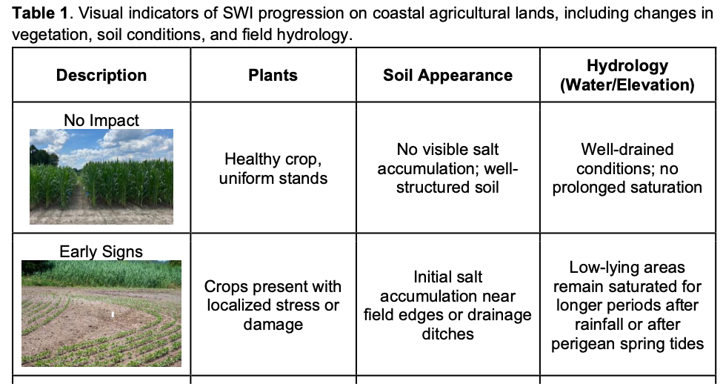

Slide 7
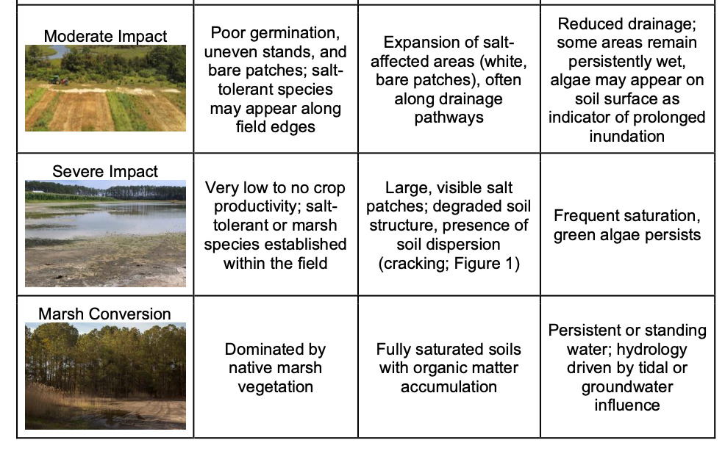

Slide 8
Visual indicators on farms
Schulenberg et al. Extension Publication (Under Review)
Select indicators that best fit a specific field to get a SWI score.
More sophisticated versions might include web platform with geospatial layers to assist with scoring.

Slide 9
Step 2: Determine the goals of the landowner
What are your primary interests/goals?
crop production
soil health
conservation
recreational activities
other

Slide 10



Step 3: Find programs & practices
Federal
State
Private

Slide 11
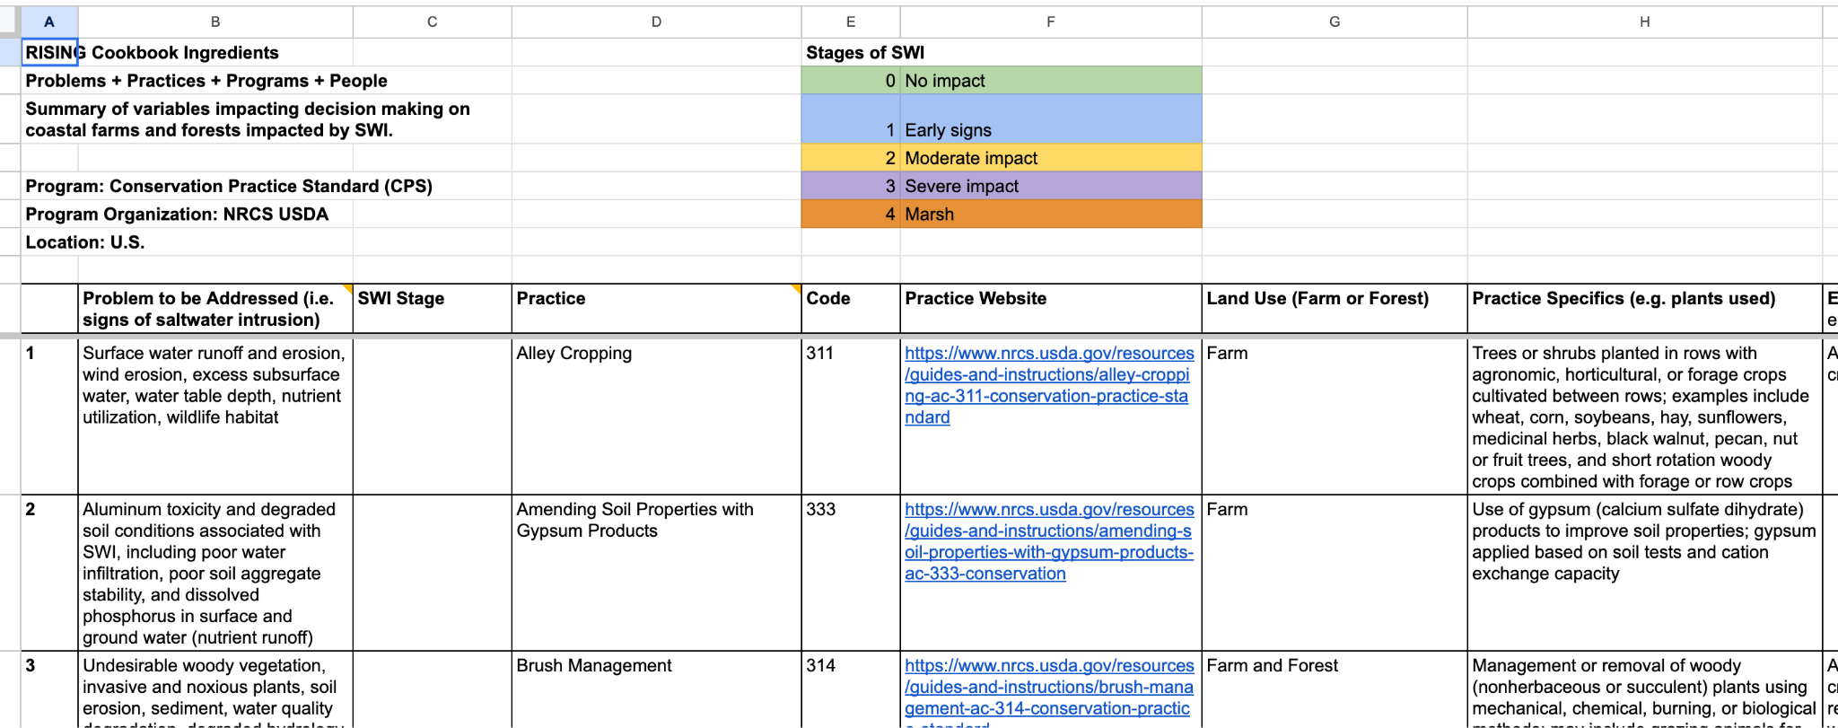

Slide 12
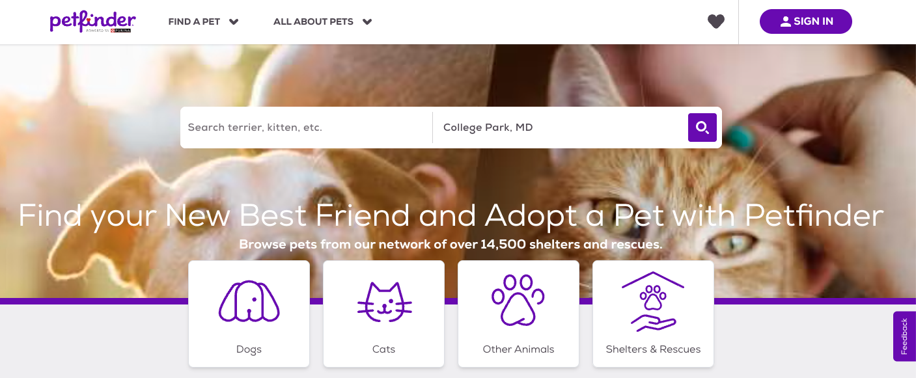

Slide 13


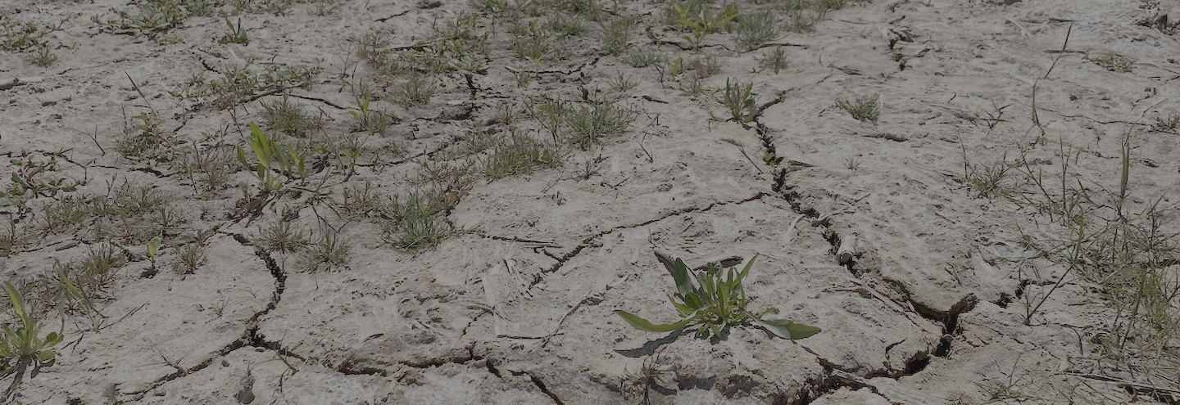
The OARS Mid-Atlantic Tool Vision
OARS Scorecards
OARS Scorecards
Find a resilience program
Sign In
Determine the stage of SWI:
State, county, ZIP code
Search by location
Farm
Forest
Both
Stage of SWI: Early Signs

